Slide 1
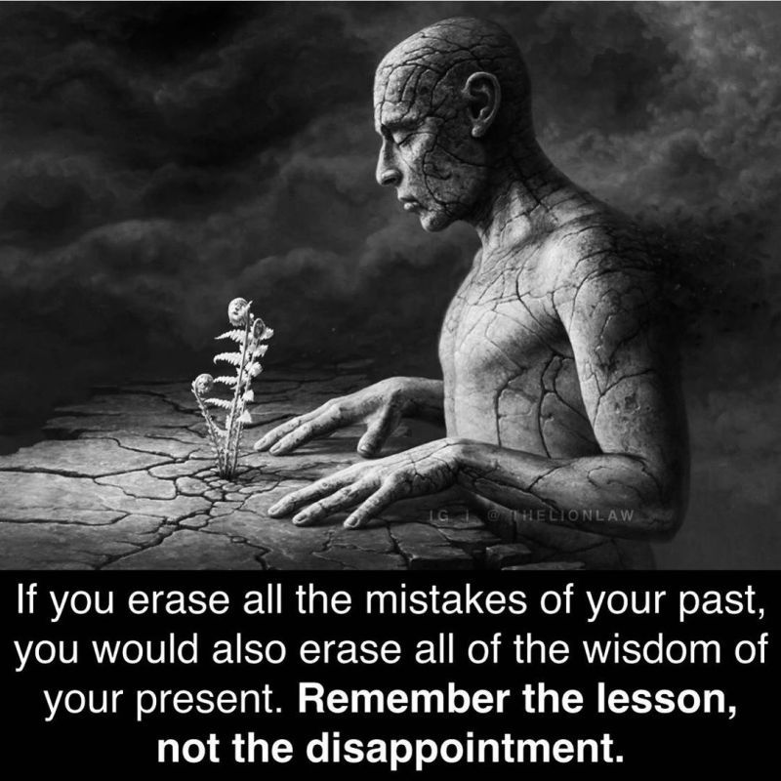
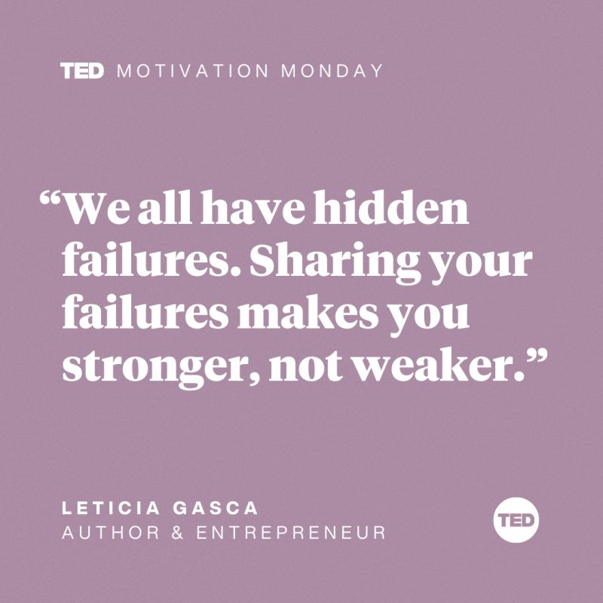
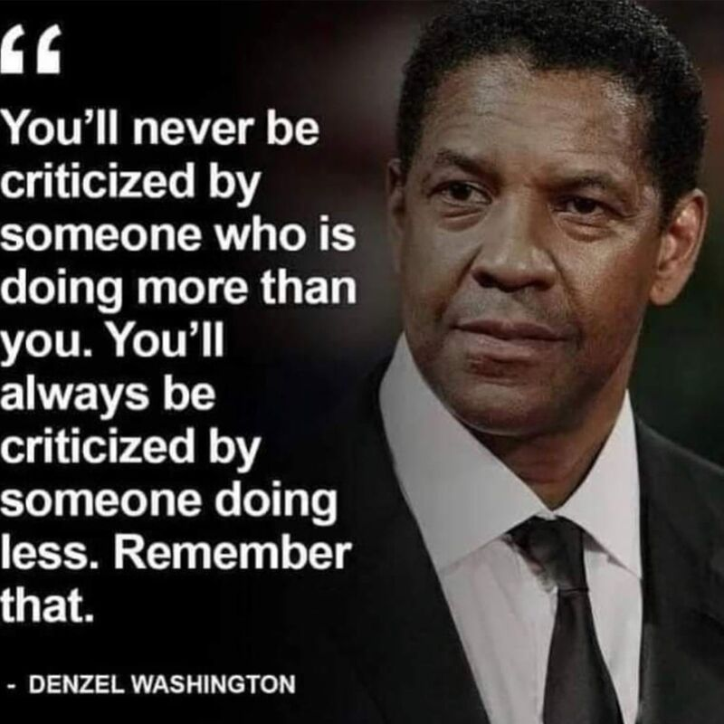
CSE 170 Technical Teamwork
W. Clements
Week 06 Day 1

Slide 2
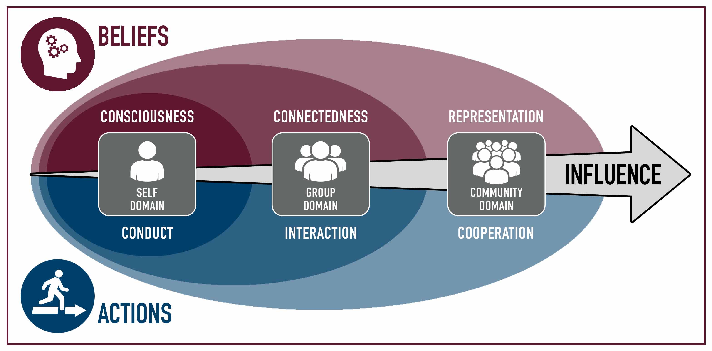
Multidimensional Influence Model (MIM)

Slide 3
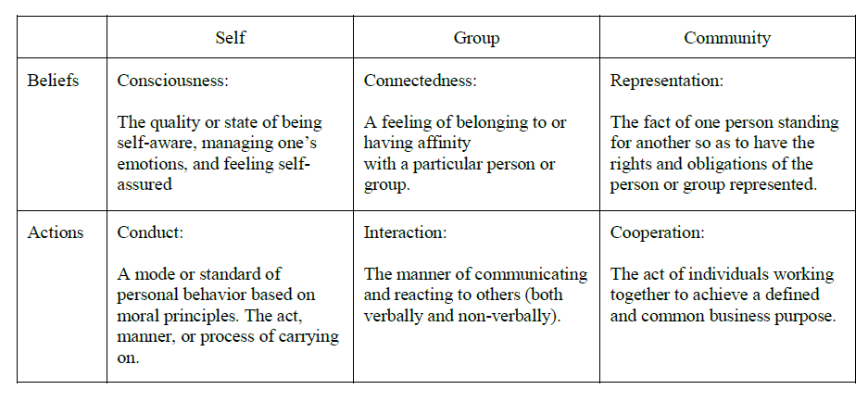
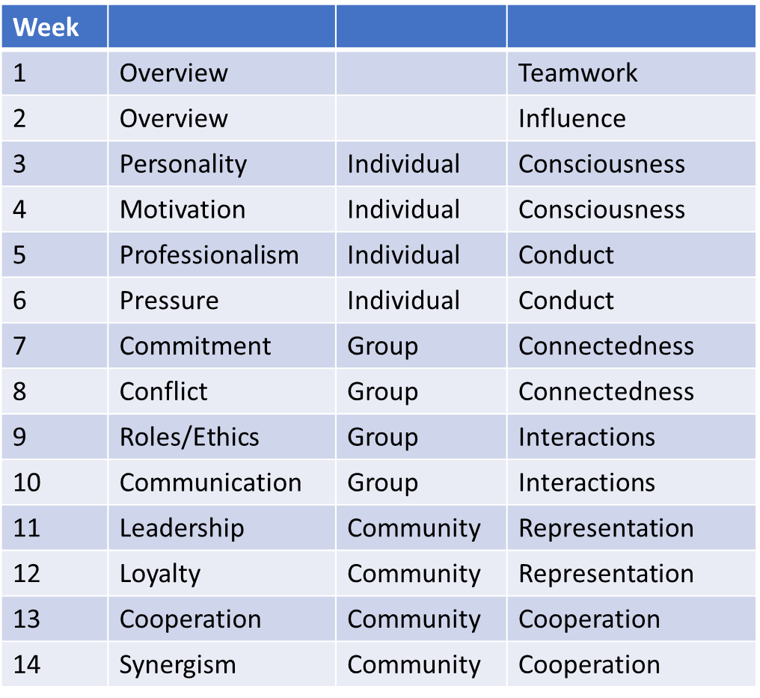
Multidimensional Influence Model (MIM)

Slide 4
Making Groups
Tables or Groups of 4-5
iLearn

Slide 5

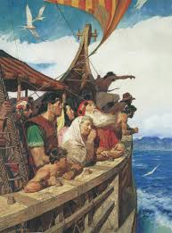

Chapter 2 of your User Manual Building your Odyssey
Based on Stanford’s Designing Thinking Course and Book: “Designing your Life”
Topics in this Chapter
Where are you?: Health, Work, Play, and Love Dashboard
Building a Compass: Workview and Lifeview
Using the compass: Keep a Good Time Journal
Idealizing: Mind Map
Create your Journey Odyssey Plan
1
2
3
4
5

Slide 6


What is holding you back?
Designers Like problems
Designers Like questions
Designers are Doers
Think like a designer
Be Curious, Try Stuff, Reframe Problems, Know it’s a process, Ask for Help
Problem Finding + Problem Solving = Well Designed Life
Gravity Problems (QuickSand)
Don’t worry about Problems that you don’t have solutions
Circle of influence
Designing to get unstuck
Start where you are. Not in the past or future

Slide 7
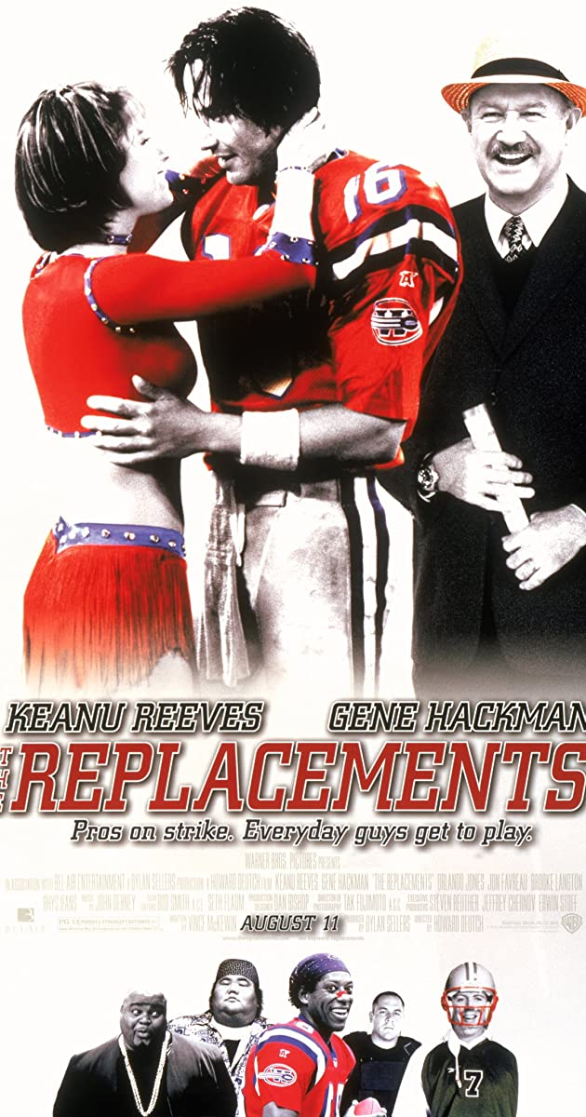

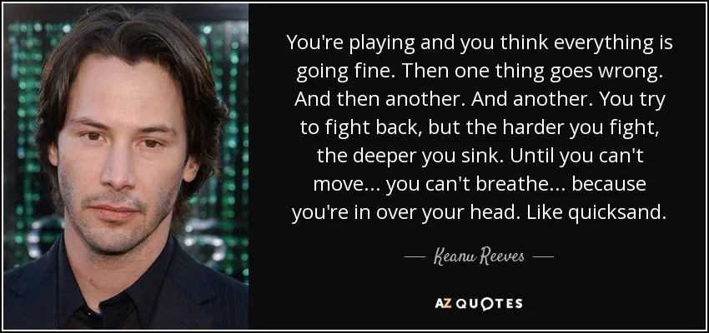
Quicksand
Movie: Replacements
Fear: What are we afraid of?
What can we do to over come fear?
Noticed: The Teach One Another moments

Slide 8


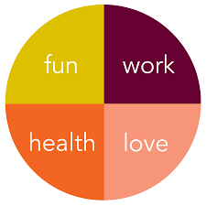
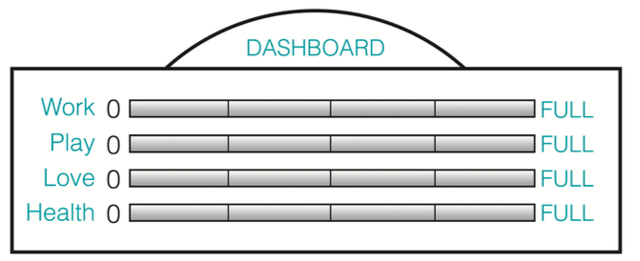
Where are you? Health, Work, Play, and Love Dashboard
Action
Define: Write a few sentences about how it’s going in each of the four areas
Measure: Mark where you are (0 or full) on each gauge
Scale: 0, ¼, ½, ¾, full
Analysis: Ask yourself if there’s a design problem you’d like to tackle in any of these areas.
Summary: Now ask yourself if the ”problem” is a gravity problem
Health
Healthy to us means being well in more than just your body; you might want to take into account mind and spirit, too.
Work
All the ways you work, paid to do, 1st and 2nd job, volunteer, home and family
Play
Bring joy. Include organized activities, and productive endeavors, for fun, not merit
Love
Where love flows in your life. Primary relationship: where we go first for love
Then it’s a flood of people, pets, communities, or objects of affection.
2 minutes each – 8-10 minutes

Slide 9
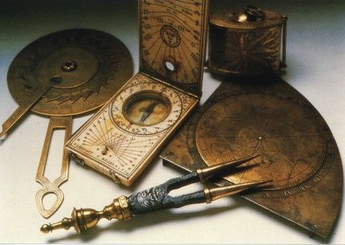
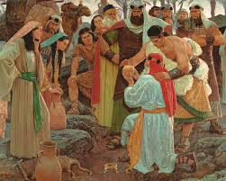
Making a Compass Workview and Lifeview
Workview Reflection
Lifeview Reflection
Write a short reflection about your Workview. (100-250 words)
Write a short reflection about your Lifeview (100-250 words)
10 minutes each – 10-20 minutes

Slide 10



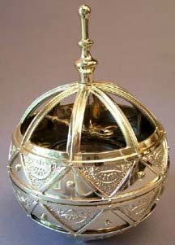
Making a Compass Workview and Lifeview
Workview Reflection
Lifeview Reflection
Why work
What’s work for?
What does work mean?
How does it relate to the individual, others, and society?
What does money have to do with it?
What do experience, growth, and fulfillment have to do with it?
Why are we here?
What is the meaning or purpose of life?
What is the relations between individual and others?
Where do family, country, and the rest of the world fit in?
What is good, and what is evil?
Is there a higher power, God, or something transcendent, and if so, what impact does this have on your life?
What is the role of joy, sorrow, justice, injustice, love, peace, and strife in life?

Slide 11
Making a Compass Workview
Workview Reflection
Write a short reflection about your Workview. (100-250 words)
Address critical issue related to what work is and what it means to you.
More than a list but a statement of your view of work
Why work?
What’s work for?
What does work mean?
How does it relate to the individual, others, and society?
What does money have to do with it?
What do experience, growth, and fulfillment have to do with it?
10 minutes each – 10-20 minutes

Slide 12
Making a Compass Lifeview
Lifeview Reflection
Write a short reflection about your Lifeview (100-250 words)
Critical defining values and perspectives provide the basis for your understanding of life.
Matters of ultimate concern and matters most to you.
Why are we here?
What is the meaning or purpose of life?
What is the relations between individual and others?
Where do family, country, and the rest of the world fit in?
What is good, and what is evil?
Is there a higher power, God, or something transcendent, and if so, what impact does this have on your life?
What is the role of joy, sorrow, justice, injustice, love, peace, and strife in life?
10 minutes each – 10-20 minutes

Slide 13
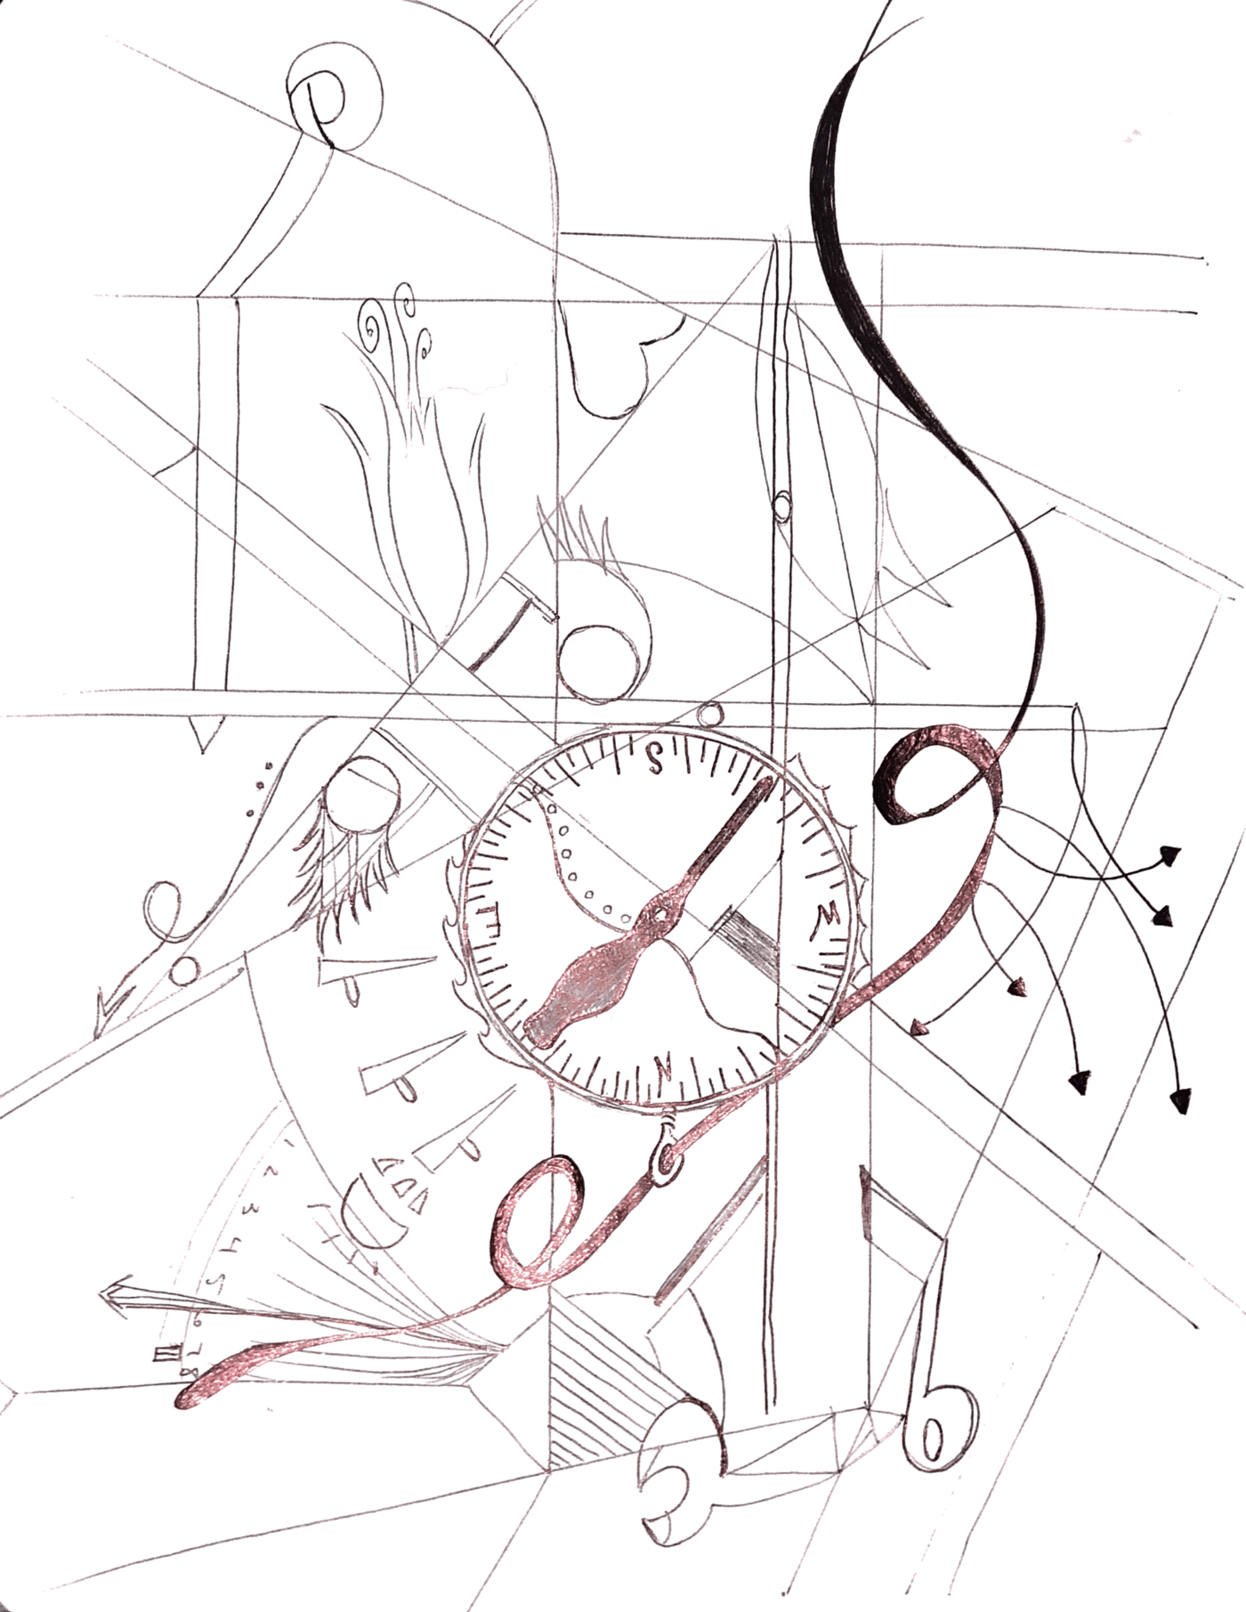
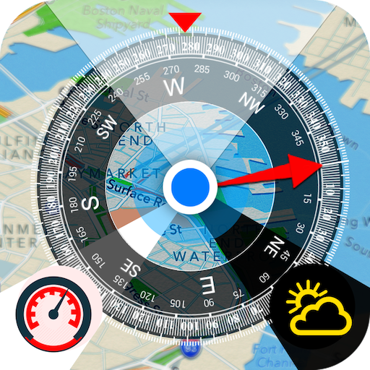

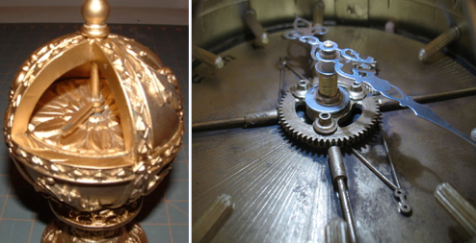
Making a Compass Workview and Lifeview – Follow-up
Workview Reflection
Lifeview Reflection
Ask these questions
Where do your view on work and life complement one another?
Where do they clash?
Does one drive the other? How?

Slide 14

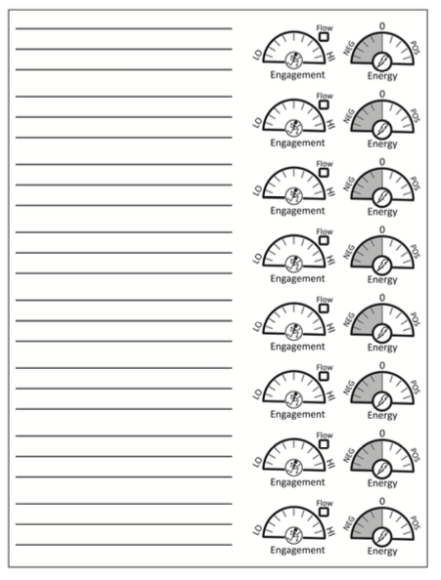
Using the compass: Keep a Good Time Journal
Complete a log of your daily activities this week.
At the end of the week jot down your reflections.
Are there any surprises?
Analysis your data, figure out what does or does not engage and energize you.
Use AEIOU method to help
Historical Data: Review the past month to year on activities that you you have done
Next two day – bring for Day 2

Slide 15

AEIOU Method
Activities What was it? Structured/Unstructured? Role?
Environments Where was it? Effects? When? Feelings?
Interactions People or Machines? Familiarity? Formal/Informal?
Objects Tools? Equipment? Inspiration? Devices?
Users Who and their role? Positive or Negative? Contributed?

Slide 16
Day 2

Slide 17
Using the compass: Keep a Good Time Journal
Complete a log of your daily activities this week.
At the end of the week jot down your reflections.
Are there any surprises?
Analysis your data, figure out what does or does not engage and energize you.
Use AEIOU method to help
Historical Data: Review the past month to year on activities that you you have done
Next two day – bring for Day 2

Slide 18
AEIOU Method
Activities What was it? Structured/Unstructured? Role?
Environments Where was it? Effects? When? Feelings?
Interactions People or Machines? Familiarity? Formal/Informal?
Objects Tools? Equipment? Inspiration? Devices?
Users Who and their role? Positive or Negative? Contributed?

Slide 19
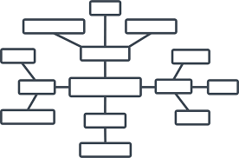
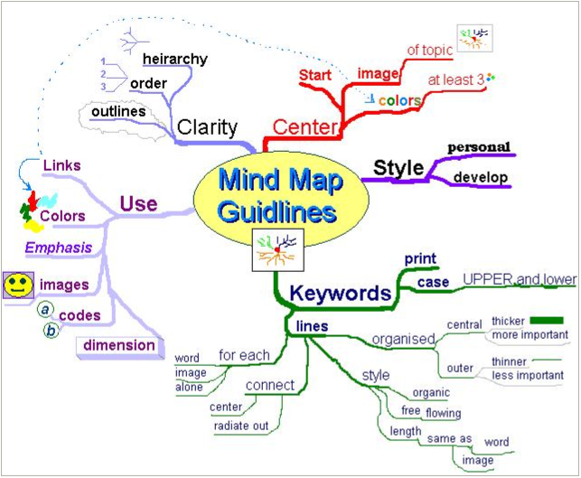
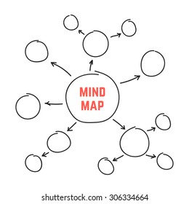
Mind Map
Mind mapping is a great tool of ideating by yourself or in a group.
Mind mapping works by using free association of words, one after another, to open up the idea space and come up with new solutions
It by passes your inner logical/verbal censor.
Review your Good Time Journal
Choose three activities, one that
Engagement: Felt you were engaged?
Energy: Highly energizing?
Flow: Brought you in the flow?
Create a mind map (2-3 layers and secondary connections)
Look at the dashboard, compass, and journal, and decide on a common topic for engagement, energy, and flow.
Create 5-6 things that come to mind.
Repeat by looking at those 5-6 things and come up with 3-4.
Repeat third layer and 4th layer.
10 minutes each – 10-20 minutes

Slide 20
Mind Map
Mind mapping is a great tool of ideating by yourself or in a group.
Mind mapping works by using free association of words, one after another, to open up the idea space and come up with new solutions
It by passes your inner logical/verbal censor.
Create a mind map (2-3 layers and secondary connections)
Look at the dashboard, compass, and journal, and decide on a common topic for engagement, energy, and flow.
Create 5-6 things that come to mind.
Repeat by looking at those 5-6 things and come up with 3-4.
Repeat third layer and 4th layer.
For each map
Look at the outer layers, pick three things that jump out.
Create a job description for each
Create a role for each job description. Draw/Find a pic/meme
10 minutes each – 10-20 minutes

Slide 21
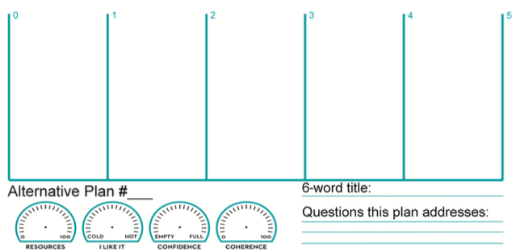
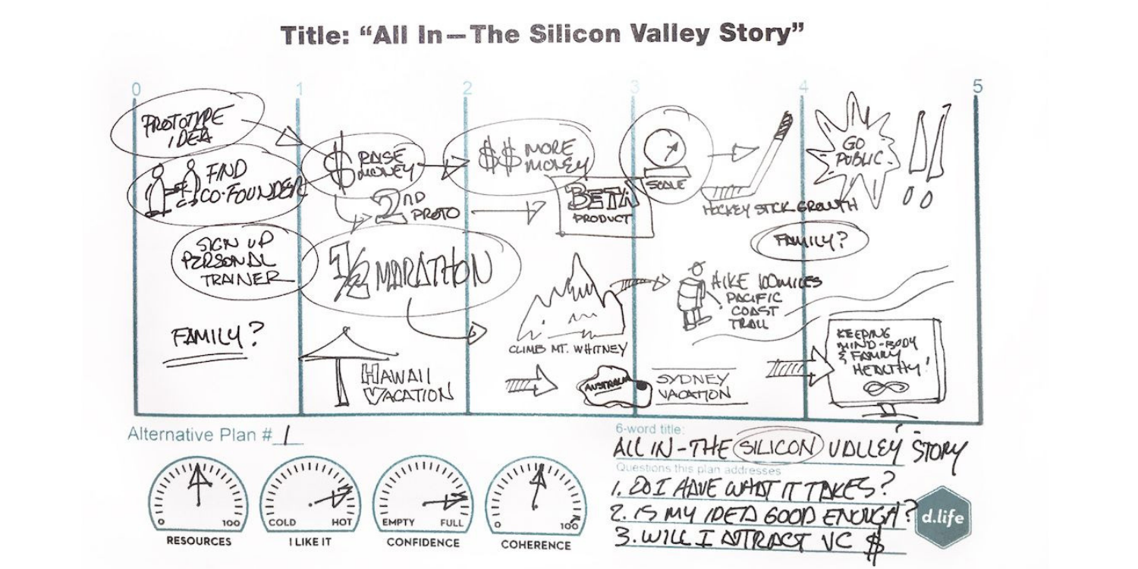
Create your Journey Odyssey Plan
Create three alternative five-year plans.
Have 5 columns, one for each year
Give each a 6-word title
Write three questions that arise out of each one
Indicate dashboard gauge
Present/Share your plan
Odyssey Plan 1: Life One
Odyssey Plan 2: Life Two
Odyssey Plan 3: Life Three

Slide 22
Create your Journey Odyssey Plan
Create three alternative five-year plans.
Give each a 6-word title
Write three questions that arise out of each one
Indicate dashboard gauge
Present/Share your plan
Odyssey Plan 1: Life One
That Thing that you Do
Odyssey Plan 2: Life Two
That Thing that you’d do if thing one were suddenly gone
Odyssey Plan 3: Life Three
The thing you you’d do or the Life you live If money or image were no object.

Slide 23
Create your Journey Odyssey Plan
Create three alternative five-year plans.
Give each a 6-word title
Write three questions that arise out of each one
Indicate dashboard gauge
Present/Share your plan
Odyssey Plan 1: Life One
That Thing that you Do
Odyssey Plan 2: Life Two
That Thing that you’d do if thing one were suddenly gone
Odyssey Plan 3: Life Three
The thing you you’d do or the Life you live If money or image were no object.

Slide 24
Create your Journey Odyssey Plan
Create three alternative five-year plans.
Give each a 6-word title
Write three questions that arise out of each one
Indicate dashboard gauge
Present/Share your plan
Odyssey Plan 1: Life One
That Thing that you Do
Odyssey Plan 2: Life Two
That Thing that you’d do if thing one were suddenly gone
Odyssey Plan 3: Life Three
The thing you you’d do or the Life you live If money or image were no object.

Slide 25
Create your Journey Odyssey Plan
Create three alternative five-year plans.
Give each a 6-word title
Write three questions that arise out of each one
Indicate dashboard gauge
Present/Share your plan
Odyssey Plan 1: Life One
Odyssey Plan 2: Life Two
Odyssey Plan 3: Life Three
10 minutes each – 10-20 minutes

Slide 26

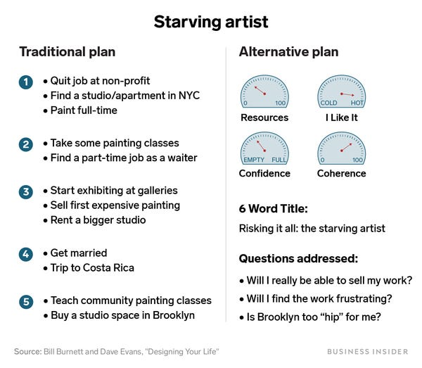
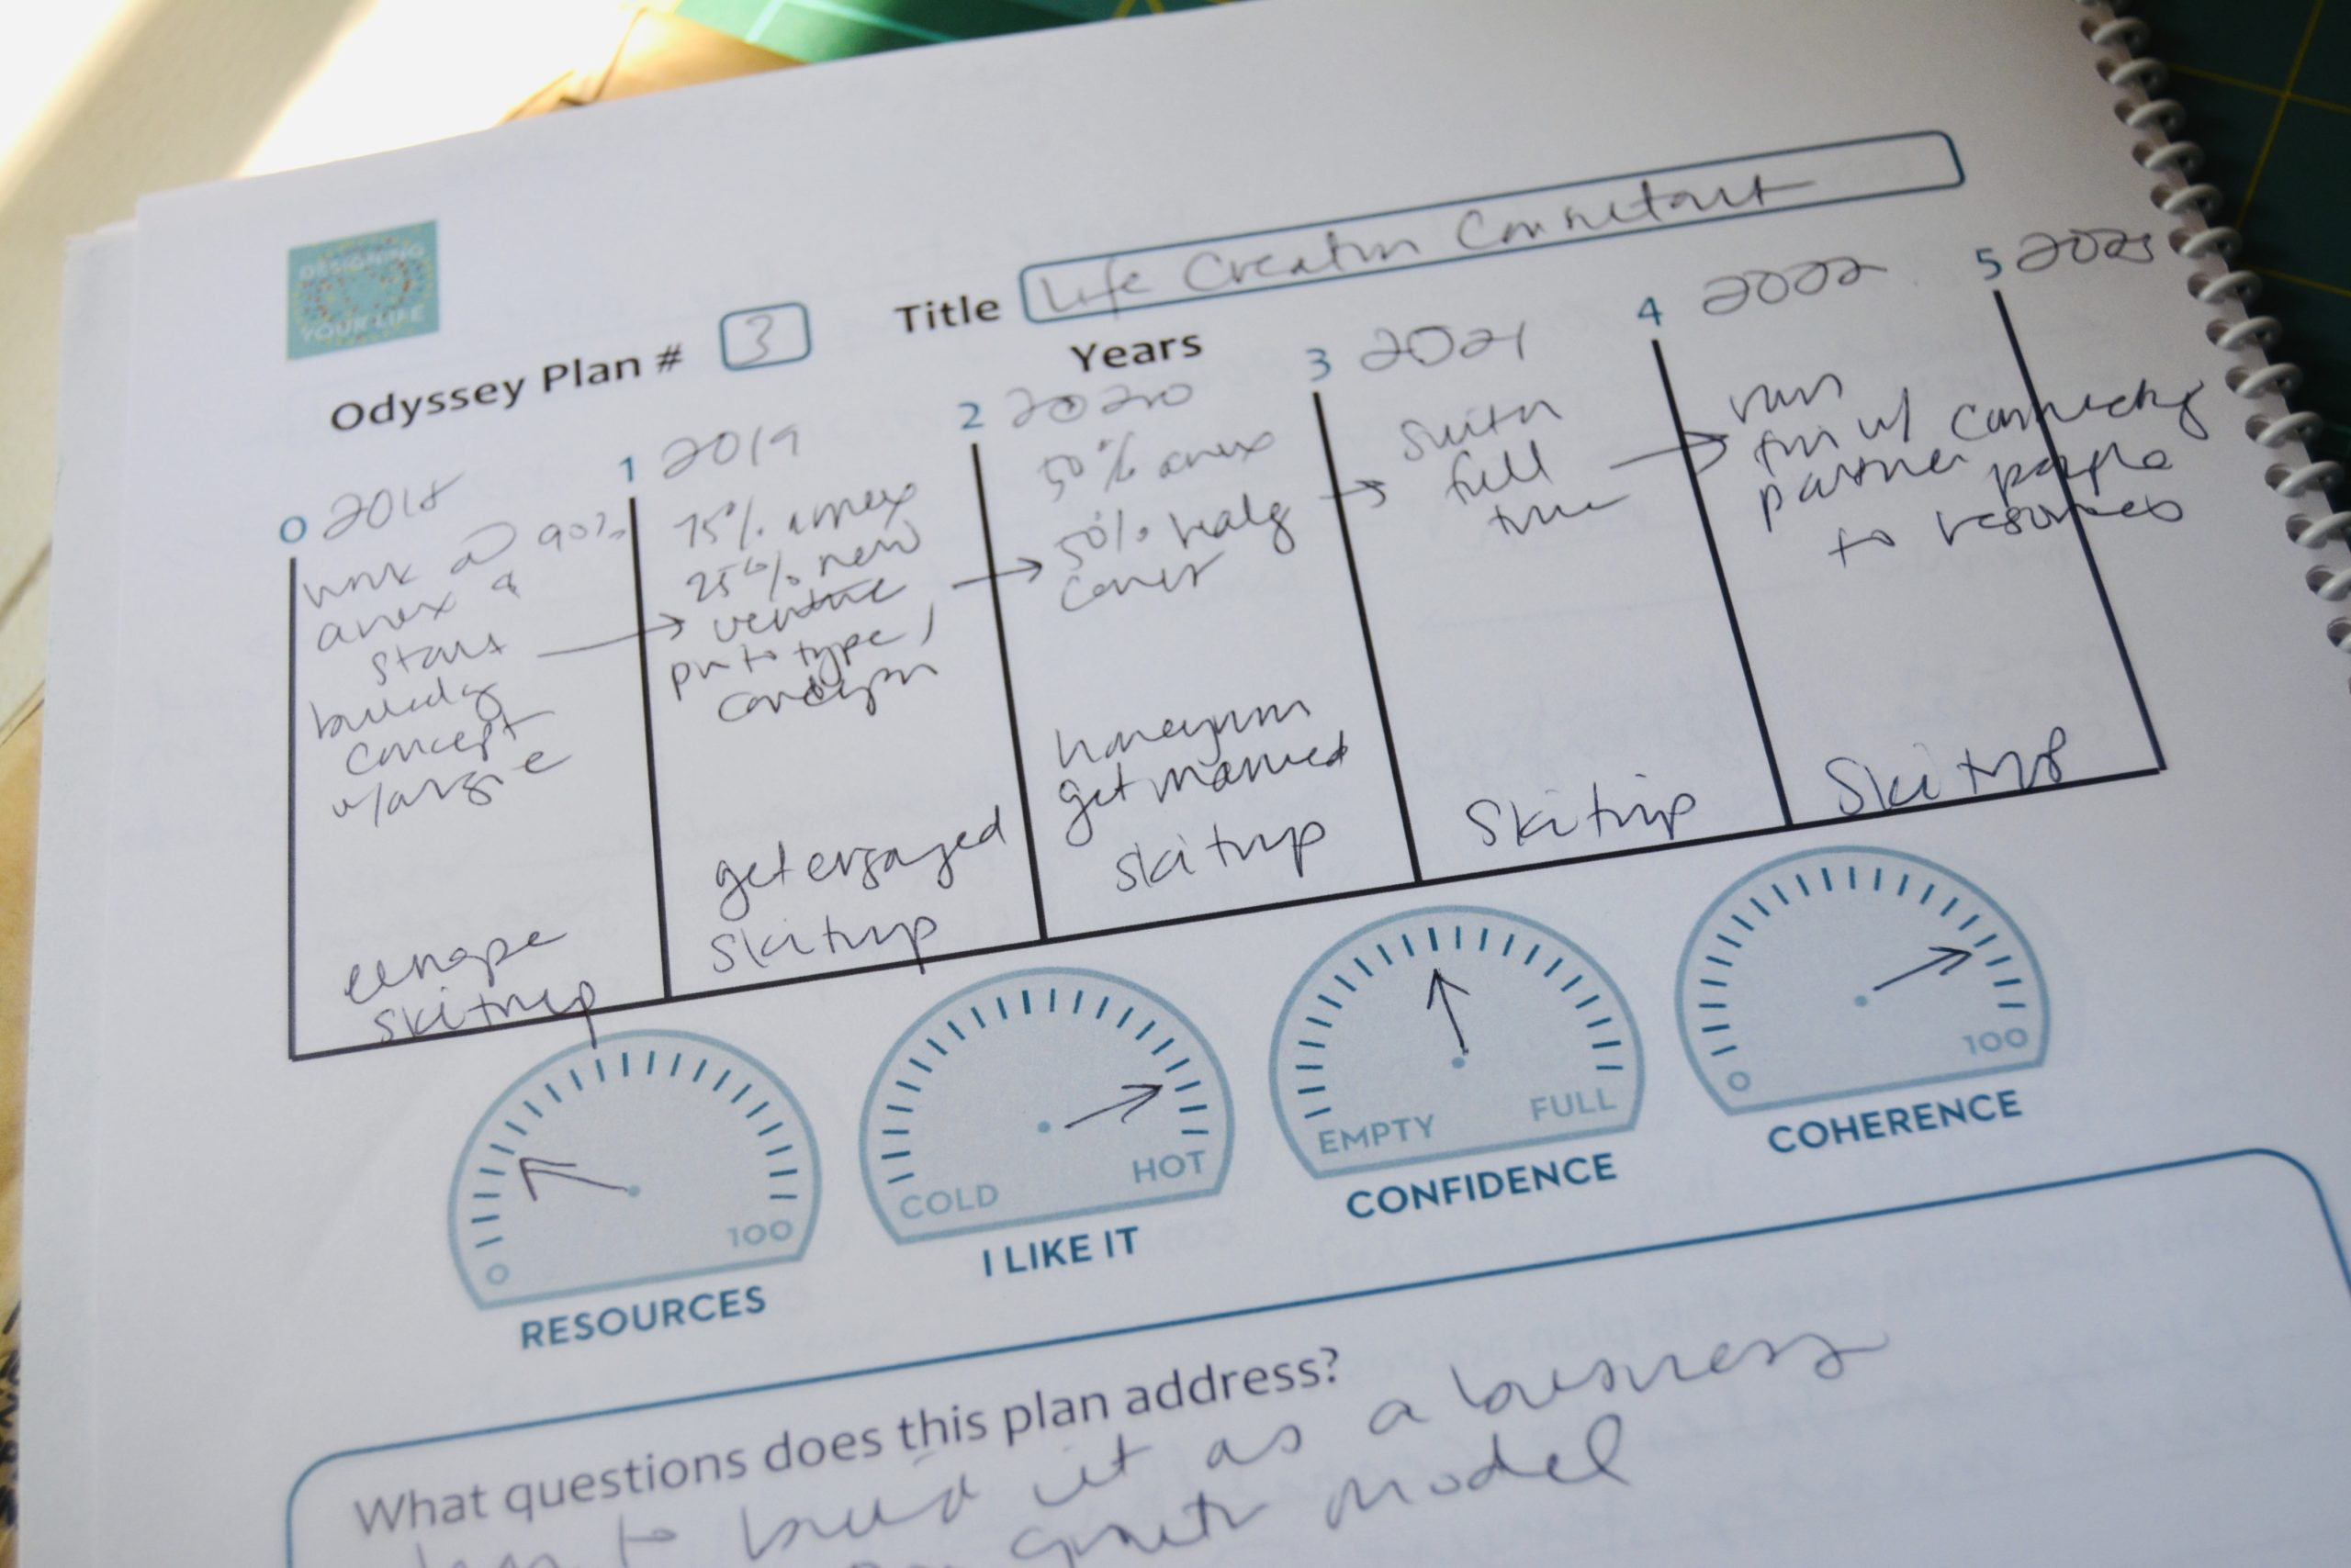
Create your Journey Odyssey Plan
Create three alternative five-year plans.
Give each a 6-word title
Write three questions that arise out of each one
Indicate dashboard gauge
Present/Share your plan
A good designer asks questions to test assumptions, reveal insights, check timelines, and look for possibilities. What do you want to test and explore about your Odyssey?

Slide 27
Create your Journey Odyssey Plan
Create three alternative five-year plans.
Give each a 6-word title
Write three questions that arise out of each one
Indicate dashboard gauge
Present/Share your plan
Four Gauges: 0-100%
Resources: time, money, skill, contacts
Likability: hot or cold, excited/apathetic.
Confidence: valid/verify, uncertain/feasabile
Coherence: make sense, match work/life views

Slide 28


Create your Journey Odyssey Plan
Create three alternative five-year plans.
Give each a 6-word title
Write three questions that arise out of each one
Indicate dashboard gauge
Present/Share your plan
In order to support you, you need a team that share your common goals.
If you don’t share how can they help.

Slide 29
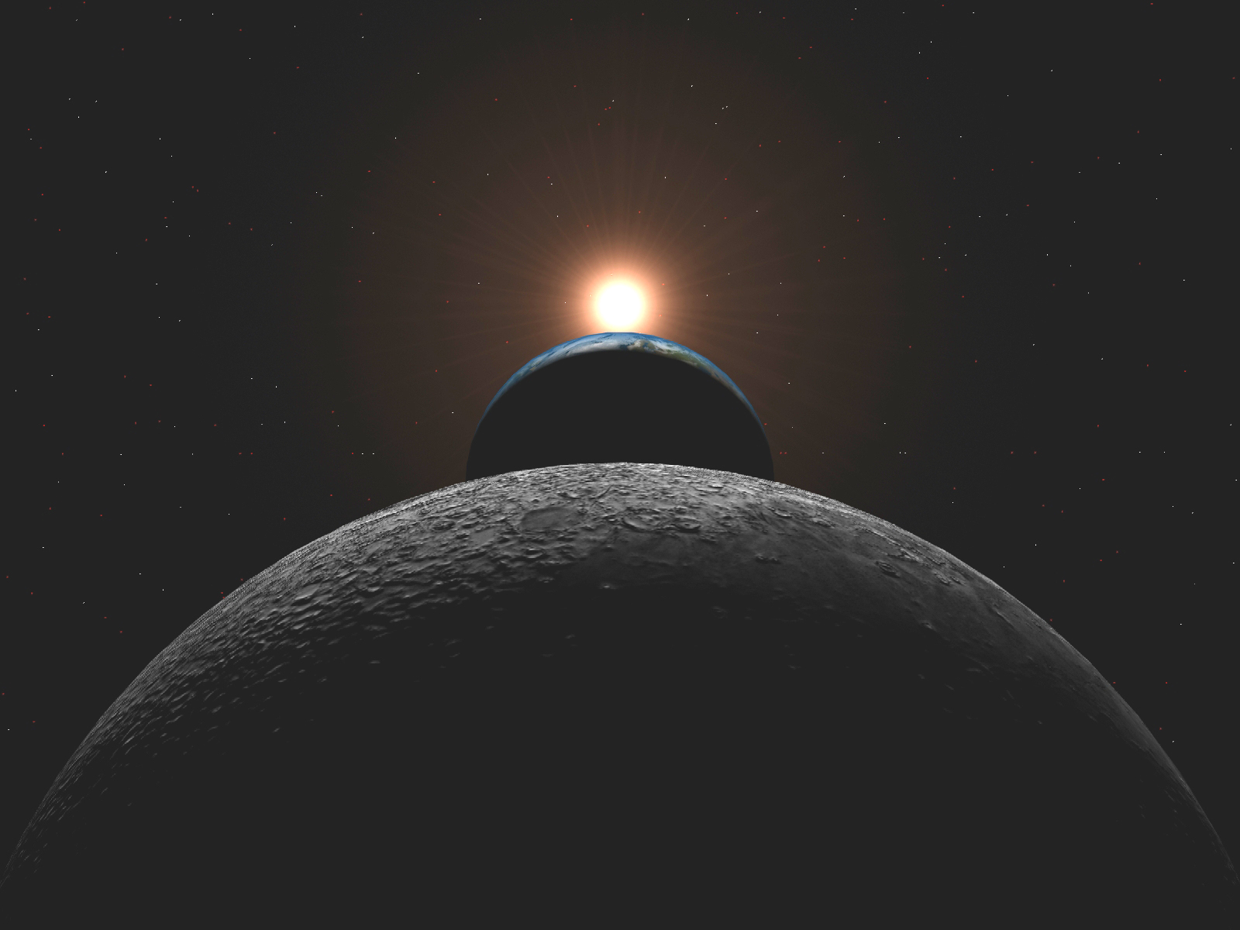
Odyssey Plan
Six columns
Year 0: Now, After Grad,
Year 1: One year from now
Year 2-5:
Title: six words max
Questions
A good designer asks questions to test assumptions, reveal insights, check timelines, and look for possibilities. What do you want to test and explore about your Odyssey?
Gauges
0-100%
Resources: time, money, skill, contacts
Likability: hot or cold, excited/apathetic.
Confidence: valid/verify, uncertain/feasabile
Coherence: make sense, match work/life views

Slide 30

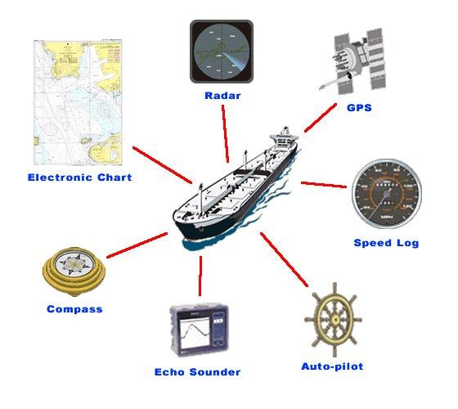
What is expected in Chapter 2
Health, Work, Play, and Love Dashboard
Define, Measure, Analysis, Summary
Workview and Lifeview Compass
Value Statement
Good Time Journal Entries
10 entries (Past or Present)
3 Mind Maps
Engagement, Energy, Flow
Odyssey Plans
Plan A, B and Unlimited

Slide 31

Steven Hinkle - Part B
Discussion: Avoiding Pressure
1) How has Steven's problems changed?
2) Do you think its possible to find a way out? Why?
3) Could he have avoided all this? How?
Handling Pressure
1) How well does Steven handle pressure?
2) What are some of the helpful/unhelpful things he does?
3) Can he get better at it? What will it take?
What Should Steven Do?
1) What should Steven say to his spouse?
2) Which problem is the most important? Why?
3) What do you think Steven should do? Why?

Slide 32
Backup Slides

Slide 33
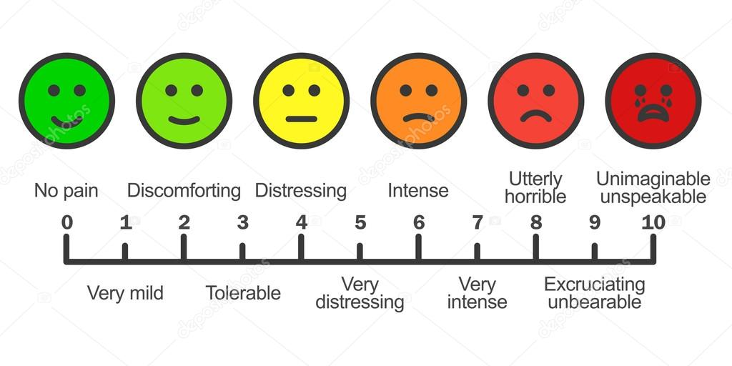
Pressures of Life
What kind of pressure do you experience in your life?
How do you feel when you are under pressure? What are the feelings?
Is it possible to avoid pressure? Why or why not?
Do you think there are unavoidable pressures? What? Why?
What are some specific things you do to avoid/handle it?
Are all these helpful? Why or why not?
What does a professional do to avoid/handle pressure at work?

Slide 34
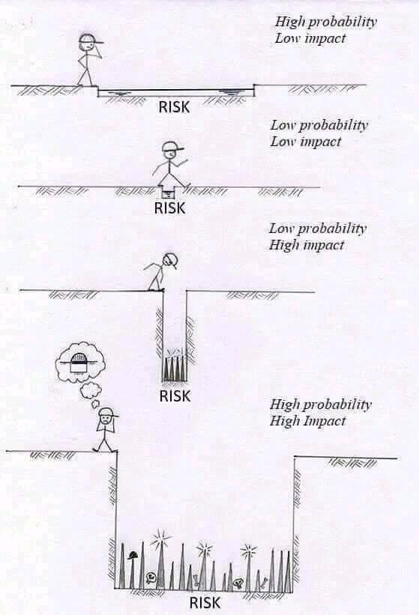
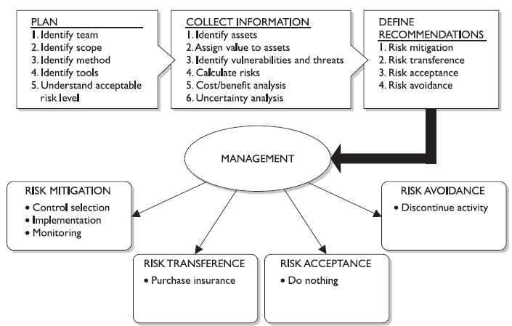
Risk Management
Different Mitigation
Prevention: Countermeasures
Transference: Insurance
Acceptance: Do Nothing
Avoidance/ Reject: Stop Activity
Prevention
------------
Probability of Occurrence
Consequences of Occurrence

Slide 35
Multiply your time by asking 4 questions about the stuff on your to-do list
Can I eliminate this task?
If I can’t eliminate this task, can I automate it?
Can it be delegated, or can I teach someone else how to do this?
Should I do this task now, or can I do it later?
Different Mitigation
Prevention: Countermeasures
Transference: Insurance
Acceptance: Do Nothing
Avoidance/ Reject: Stop Activity
https://ideas.ted.com/multiply-your-time-by-asking-4-questions-about-the-stuff-on-your-to-do-list/

Slide 36
Family Feud
Two Teams
One from each team to start, first answer gets the turn
Each team, gets 3 wrong answers.

Slide 37

How To Avoid Mistakes At Work?
1. Give Full Attention To What You’re Doing
2. Avoid Distractions
3. Take Breaks
4. Ask Questions
5. Create a Checklist
6. Be Clear About Your Role
7. Review
8. Learn From Your Mistakes

Slide 38

How to Improve Your Work-Life Balance What is work-life balance, and why is it important?
8 Ways to create a better work-life balance
How to be a supportive manager
1. Accept that there is no 'perfect' work-life balance.
2. Find a job that you love.
3. Prioritize your health.
4. Don't be afraid to unplug.
5. Take a vacation.
6. Make time for yourself and your loved ones.
7. Set boundaries and work hours.
8. Set goals and priorities (and stick to them).
Know what your employees are striving for
Set a good example
Let employees know what their options are
Let employees know what their options are

Slide 39


Why Finding Meaning At Work Is More Important Than Feeling Happy
Happiness vs. Meaning
Your why vs your what
How do we find meaning at work?
Taker vs Giver
Strategies
1. Become a Master Crafter: Give More of Your Talent
2. Ignore the What and Heed the Why
3. Remember That Other People Matter
We are in the people business; we solve people’s problems.

Slide 40

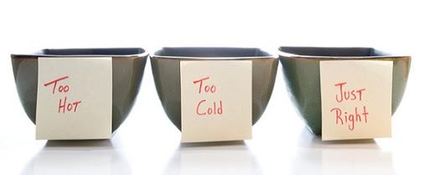
The "Just Right" Reaction When You Mess Up at Work
Situation #1: Too Hot
Over apologizing
To Her: Cares To Others: Annoying & Can’t handle tough
Situation #2: Too Cold
Lame Excuse
To Him: Mitigating To Others: Insincere and Doesn’t Care
Situation #3: Just Right
No knee jerk reaction
There is risk in a job, address when and where it happens, after mitigation has been applied.
Risk = Opportunities
If mistakes are learning opportunities, I try to learn three new things every day - Clements

Slide 41
Family Feud
Two Teams
One from each team to start, first answer gets the turn
Each team, gets 3 wrong answers.

Slide 42

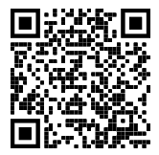
"Stress and Anxiety" quiz.
https://greatergood.berkeley.edu/quizzes/take_quiz/stress_and_anxiety
Your score is XX out of 48, which suggests that you experience <> levels of anxiety and an <> amount of stress in your life.
What are some of the suggestions provided?
Notes:
https://greatergood.berkeley.edu/quizzes/take_quiz/stress_and_anxiety
Here are three suggestions for countering it.
Work through difficult feelings. The practice of Expressive Writing allows you to give voice to your deepest emotions and thoughts surrounding a challenge you’re going through, which can help reduce stress and boost happiness in the long term.
Find the Silver Lining. Although it might be cliche, the habit of looking on the bright side of a situation may actually counter pessimism and depression.
Take care of yourself. Practicing self-compassion rather than self-criticism in the face of difficult situations leads to better outcomes. Consider writing a Self-Compassionate Letter to help you develop compassion, understanding, and acceptance toward a part of yourself that you dislike. If you have trouble, ask yourself: How would you treat a friend?
Find activities to de-stress. Spend time in nature, exercise, or meditate.
Lower stress at home with Christine Carter’s tips.
Overcome a Fear. If a mild, everyday fear is at the heart of your anxiety, this practice of slowly confronting it may help you cope.

Slide 43

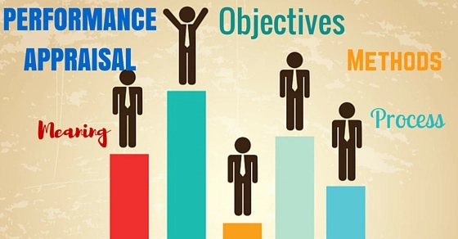

Performance Evaluations
Why do company’s provide performance evaluations? Or why should company’s provide performance evaluations?
What should they evaluate you on?
How are you going to be rated? Should be rate? Rating your self?

Slide 44
